Slide 1
Azure SQL
This slide deck contains information and learnings around Azure SQL

Slide 2
Where do I start ?
Resources
  Migration Cookbook: https://azure.microsoft.com/en-gb/blog/migration-cookbook-now-available-for-the-latest-azure-sql-database-update-v12/
  Azure SQL Database Documentation: https://docs.microsoft.com/en-us/azure/sql-database/sql-database-technical-overview
  Azure SQL Database DTU Calculator: http://dtucalculator.azurewebsites.net/
  Migrating from non-SQL Server DB such as Oracle ?: https://blogs.msdn.microsoft.com/datamigration/2016/12/22/released-sql-server-migration-assistant-ssma-v7-2/
Tools
  SQL Server Data Tools for Visual Studio (SSDT): https://msdn.microsoft.com/en-gb/mt186501
  SQL Server Management Studio (SSMS): https://docs.microsoft.com/en-us/sql/ssms/download-sql-server-management-studio-ssms
  Old: SQL Azure Migration Wizard http://sqlazuremw.codeplex.com/
  New: Azure Data Migration Assistant: https://www.microsoft.com/en-us/download/details.aspx?id=53595
  Try it!
  TechNet Virtual Lab - https://vlabs.holsystems.com/vlabs/technet?eng=VLabs&auth=none&src=vlabs&altadd=true&labid=13209

Slide 3
SQL Database
Azure SQL Database is a relational database service with mission-critical capabilities, based on the SQL Server engine, delivering predictable performance, scalability with no downtime, business continuity and data protection, all with minimal administration
Highly compatible V12 engine
Available in three service tiers
  Can change on the fly, by creating a replica of the original database at the new performance level
  Some transactions in flight may be rolled back, downtime usually under four seconds
Basic: suited for a small database, supporting typically one single active operation at a given time. Examples include databases used for development or testing, or small-scale infrequently used applications
  2 GB max database size
  30 max concurrent workers / sessions
Standard: go-to option for most cloud applications, supporting multiple concurrent queries
  250 GB max database size
  200 max concurrent workers / sessions
Premium: Designed for high transactional volume, supporting many concurrent users and requiring the highest level of business continuity capabilities. Examples are databases supporting mission critical applications
  1 TB max database size
  6400 max concurrent workers / sessions

Slide 4
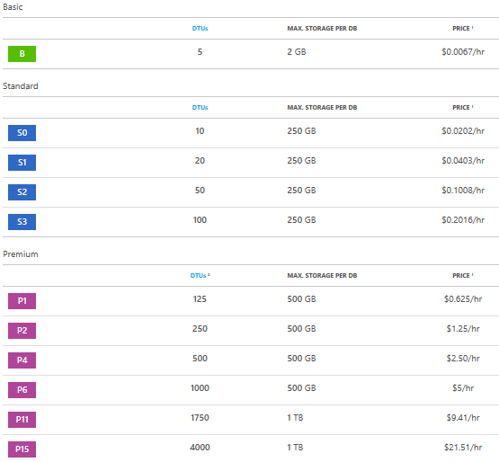
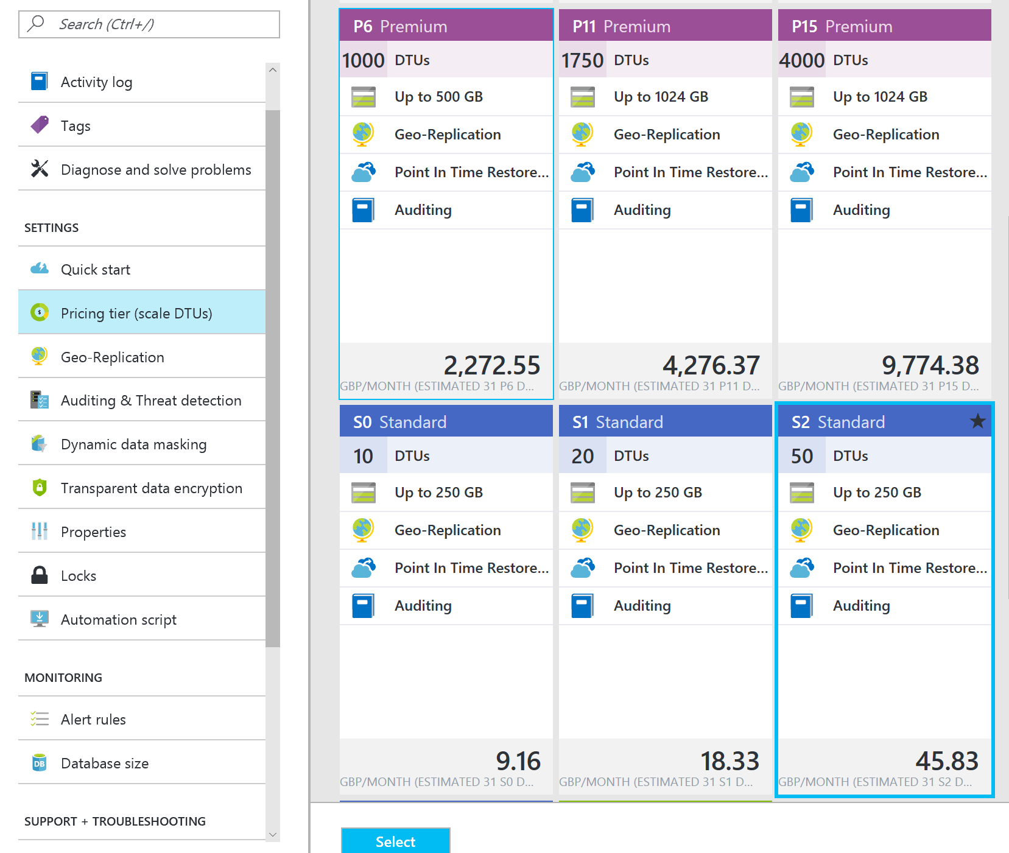
SQL Database – Pricing

Slide 5
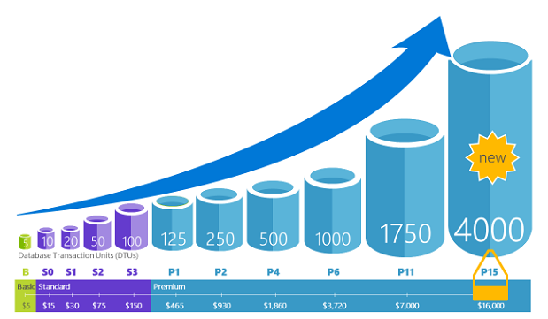
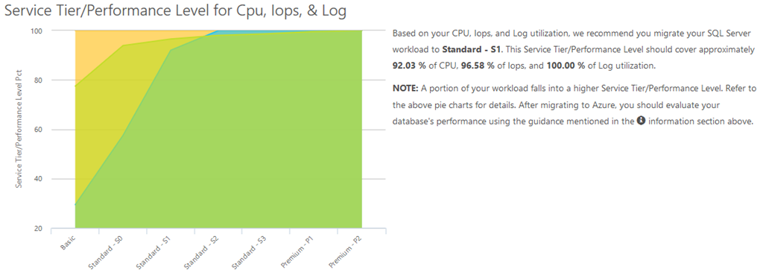
SQL Database – DTUs
Database Transaction Units (DTUs)
  measure of CPU, memory, data I/O, transaction log I/O in designed to simulate real-world OLTP workloads
  Describes the relative capacity
Azure SQL Database Benchmark (ASDB)
Third party DTU Calculator
  dtucalculator.azurewebsites.net

Slide 6
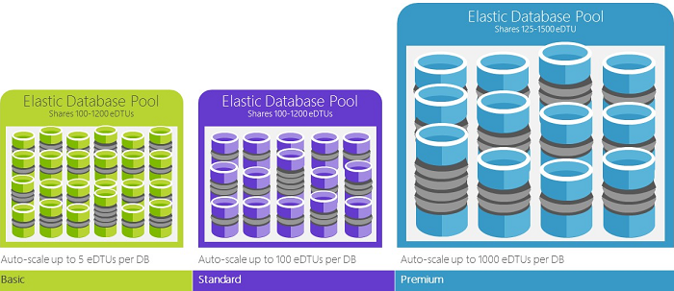
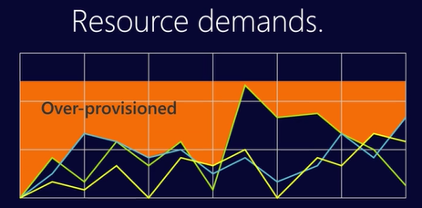
SQL Database – elastic DTUs
Elastic pools provide simple cost effective solution to manage performance goals for multiple databases with varying and unpredictable usage patterns
  E.g. multi-tenant solutions using a single-tenant per database
Within the pool, individual databases are given the flexibility to auto-scale within set parameters
  Set minimum and maximum DTUs
  Avoid auto-provision
Not all single databases are optimum candidates for pools

Slide 7
SQL Database - Business Continuity
Point in Time Restore
  Automatic combination of full/weekly/differential database backups hourly, transaction log backups every five minutes
  Retention 7 day (Basic), 35 days (Standard/Premium)
  Long-Term Backup Retention feature enables storage of backups in an Azure Recovery Services vault for up to 10 years
    Or BACPAC to blob storage
  In most cases, recovery time is less than 12 hours
  Best suited for
    Non-mission critical / non binding SLA
    Possible lost of data up to one hour
    Cost sensitive

Slide 8
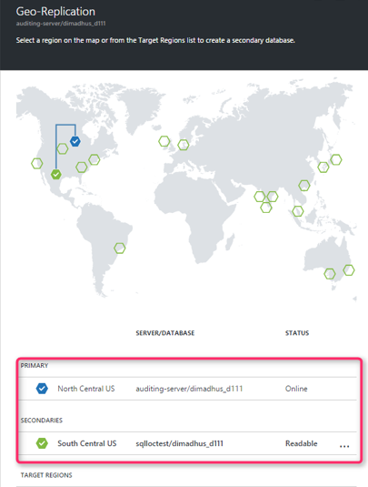
SQL Database - Active Geo-Replication
Active Geo-Replication available in all tiers
Up to four readable secondary databases in the same / different data center locations
  Asynchronously replicates committed transactions using read committed snapshot isolation (RCSI) for isolation
Secondary databases for failover for data center outage or inability to connect to the primary database
  Offload read-only workloads such as reporting jobs

Slide 9
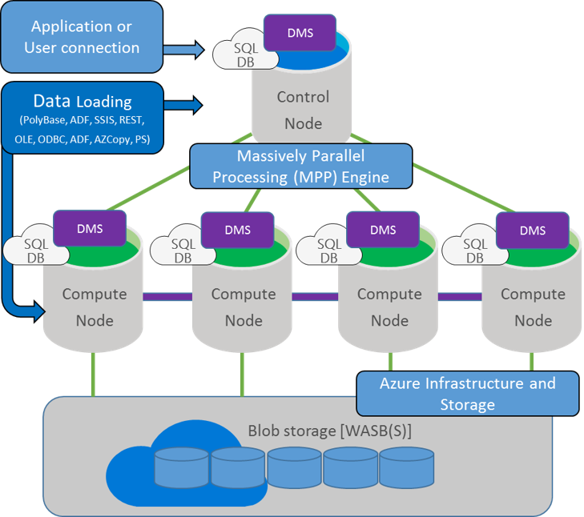
SQL Data Warehouse
SQL Data Warehouse combines the SQL Server relational database with Azure cloud scale-out capabilities, using a massively parallel processing (MPP) architecture
Scale beyond any single system by using shared-nothing storage and processing units
  Data is stored in Premium locally redundant storage
Requests processed by control node, optimized and passed to the compute nodes to work in parallel
  Control node looks like / powered by SQL Database
  Translates T-SQL to parallel work
Pay only for scaled out CPU work and blob storage

Slide 10
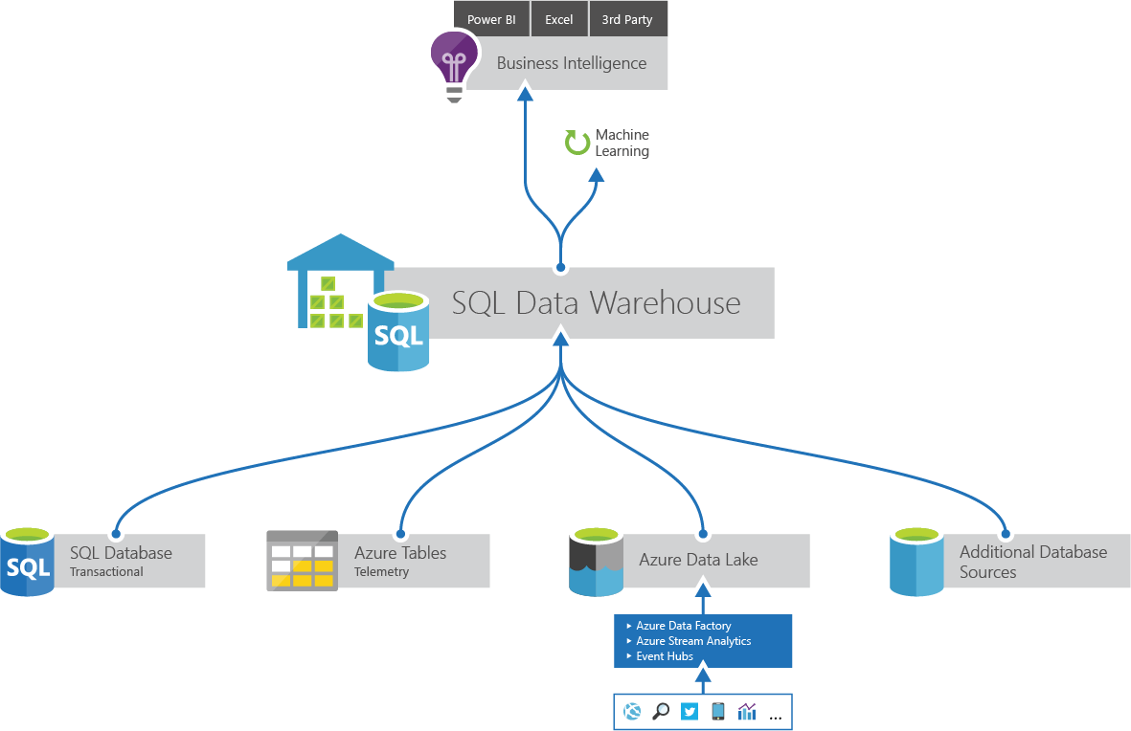
SQL Data Warehouse - DWU
Allocation of resources is measured in Data Warehouse Units (DWUs)
Metric designed to scale linearly
  Scan/Aggregation: standard data warehousing query that scans large number of rows and then performs a complex aggregation
    I/O and CPU intensive operation
  Load: measures ability to ingest data into the service using PolyBase to load data set from Azure Blob storage
    stress network and CPU
  Create Table As Select: measures the ability to copy a table
    CPU, IO and network intensive operation

Slide 11
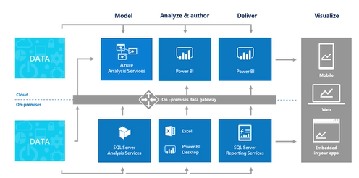
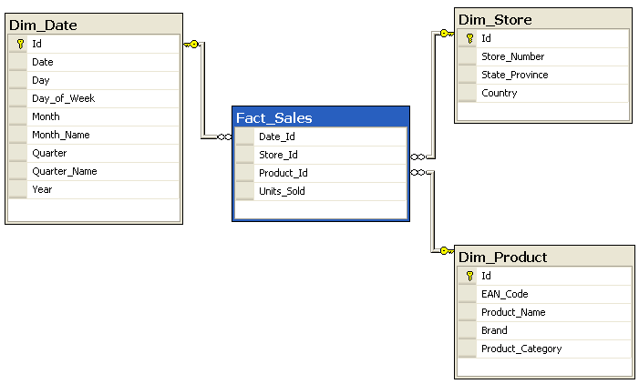
Azure Analysis Services
Build a BI Semantic Model of data
  “Semantic” in the context of data warehouses means “from the user’s perspective”
Sits between the data source and the end user experience
  Integrate data from multiple data sources
  Reporting and dashboards, such as Power BI
Tabular Model
  xVelocity/Vertipaq in-memory analytics engine
  4 – 15 factor compression
Design star/snowflake schema
  Fact tables referencing dimension table
  Aggregate up and drill down dimensions
Billing is cache size and query processing units

Slide 12

What won’t work out of the box?

Slide 13
What won’t work out of the box?
  •Collation of system objects
  •Connection related: Endpoint statements, ORIGINAL_DB_NAME. SQL Database does not support Windows authentication, but does support the similar Azure Active Directory authentication. Some authentication types require the latest version of SSMS. For more information, see Connecting to SQL Database or SQL Data Warehouse By Using Azure Active Directory Authentication.
  •Cross database queries using three or four part names. (Read-only cross-database queries are supported by using elastic database query.)
  •Cross database ownership chaining, TRUSTWORTHY setting
  •DATABASEPROPERTY Use DATABASEPROPERTYEX instead.
  •EXECUTE AS LOGIN Use 'EXECUTE AS USER' instead.
  •Encryption is supported except for extensible key management
  •Eventing: events, event notifications, query notifications
  •Syntax related to database file placement, size, and database files that are automatically managed by Microsoft Azure.
  •Syntax related to high availability, which is managed through your Microsoft Azure account. This includes syntax for backup, restore, Always On, database mirroring, log shipping, recovery modes.
  •Syntax that relies upon the log reader, which is not available on SQL Database: Push Replication, Change Data Capture. SQL Database can be a subscriber of a push replication article.
  •Syntax that relies upon the SQL Server Agent or the MSDB database: alerts, operators, central management servers. Use scripting, such as Azure PowerShell instead.
  •Functions: fn_get_sql, fn_virtualfilestats, fn_virtualservernodes
  •Global temporary tables
  •Syntax related to hardware-related server settings: memory, worker threads, CPU affinity, trace flags, etc. Use service levels instead.
  •HAS_DBACCESS
  •KILL STATS JOB
  •OPENQUERY, OPENROWSET, OPENDATASOURCE, BULK INSERT, and four-part names
  •.NET Framework CLR integration with SQL Server
  •Semantic search
  •Server credentials. Use database scoped credentials instead.
  •Server-level items: Server roles, IS_SRVROLEMEMBER, sys.login_token. GRANT, REVOKE, and DENY of server level permissions are not available though some are replaced by database-level permissions. Some useful server-level DMVs have equivalent database-level DMVs.
  •SET REMOTE_PROC_TRANSACTIONS
  •SHUTDOWN
  •sp_addmessage
  •sp_configure options and RECONFIGURE. Some options are available using ALTER DATABASE SCOPED CONFIGURATION.
  •sp_helpuser
  •sp_migrate_user_to_contained
  •SQL Server audit. Use SQL Database auditing instead.
  •SQL Server trace
  •Trace flags. Some trace flag items have been moved to compatibility modes.
  •Transact-SQL debugging
  •Triggers: Server-scoped or logon triggers
  •USE statement: To change the database context to a different database, you must make a new connection to the new database.

Slide 14
In summary – these constructs are not supported
SQL Server Feature | Consider this Azure Feature instead
Change Data Capture | SQL Database Change Tracking / Triggers
SQLCLR | Azure Functions
AlwaysOn Availability Groups | SQL Database Active Geo-Replication
Database mail | Azure Functions / SendGrid
Database mirroring | SQL Database Active Geo-Replication
Data Quality Services | N/A
FILESTREAM | Azure Blob Storage
Linked Servers | SQL Database Elastic Query
Database snapshots | SQL Database Point in time restore
Data Replication | SQL Database Active Geo-Replication
Polybase | Azure SQL Data Warehouse, Azure SQL Database Elastic Scale / Query
Extended stored procedures | Azure Functions / Azure Automation
Service broker | Azure Service Bus / Azure Functions
SQL Server Agent | Azure Automation / Azure Functions
Windows authentication | SQL Database Azure Active Directory Authentication
Non Database Engine Features (SSAS, SSRS, SSIS) | Azure Analysis Services, Power BI Embedded, Azure Data Factory

Slide 15
Authentication in Azure SQL Database
NO Windows authentication
Authenticate with either Azure AD Authentication or SQL Authentication
Consider impact to replication of databases by using partially contained databases for user identities.
i.e. Put contained users into the database and / or map these to Azure AD identities.
https://msdn.microsoft.com/en-us/library/ff929188.aspx
https://docs.microsoft.com/en-us/azure/sql-database/sql-database-control-access-sql-authentication-get-started
https://docs.microsoft.com/en-gb/azure/sql-database/sql-database-aad-authentication

